Slide 1


Slide 2


Slide 3

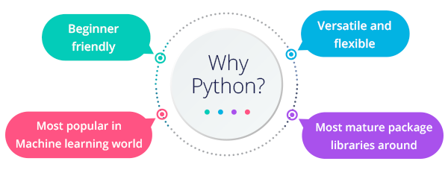
python

Slide 4
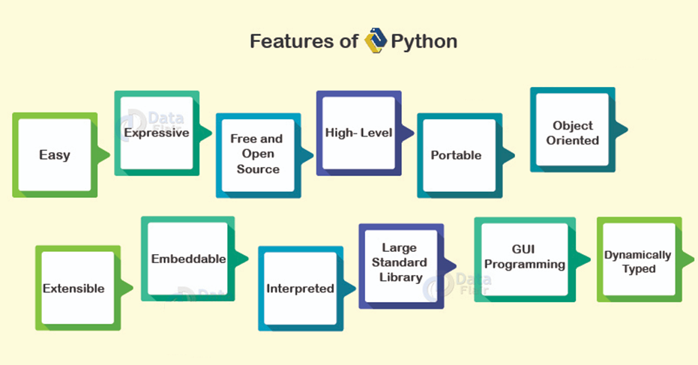
python

Slide 5

python

Slide 6
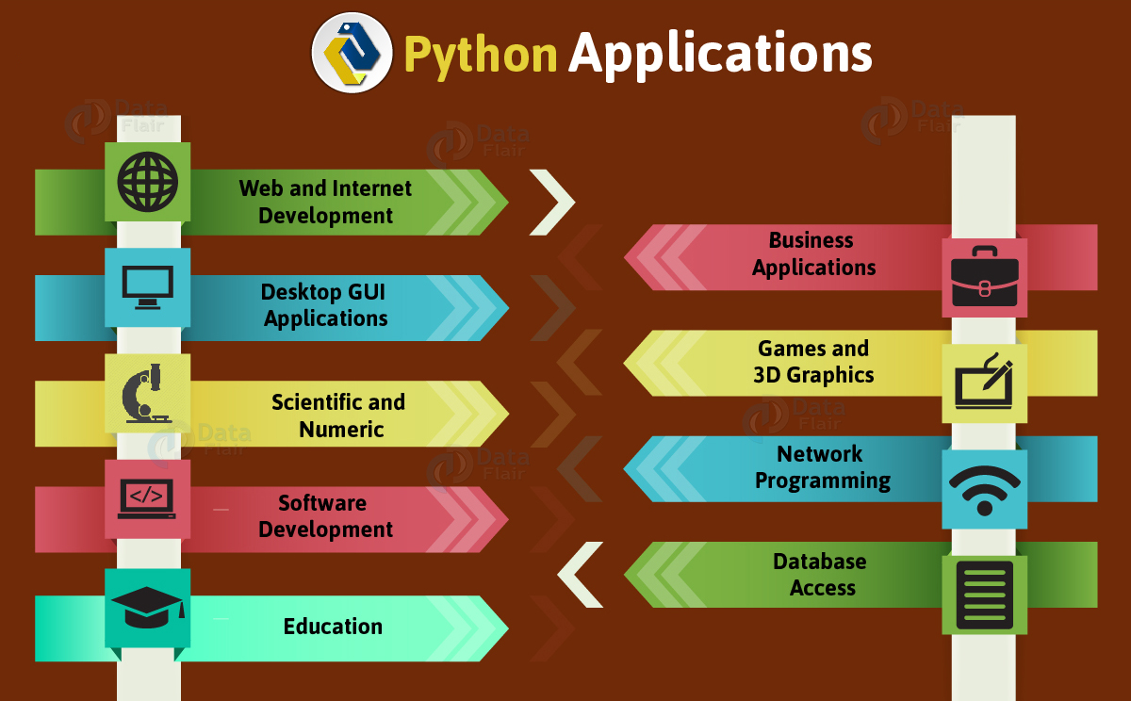

Slide 7
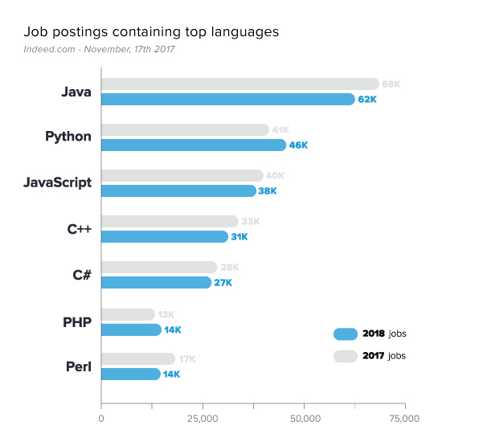
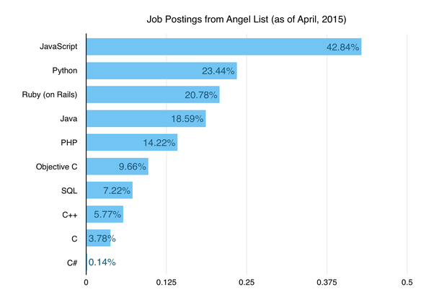
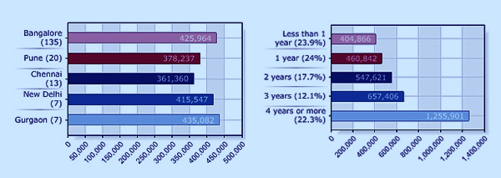
python salary

Slide 8


Slide 9
python
Simple
Python is a simple and minimalistic language in nature
Reading a good python program should be like reading English
Its Pseudo-code nature allows one to concentrate on the problem rather than the language
Easy to Learn
Free & Open source
Freely distributed and Open source
Maintained by the Python community
High Level Language –memory management
Portable – *runs on anything c code will

Slide 10
python
Interpreted
You run the program straight from the source code.
Python program →Bytecode →a platforms native language
You can just copy over your code to another system and it will auto-magically work! *with python platform
Object-Oriented
Simple and additionally supports procedural programming
Extensible – easily import other code
Embeddable –easily place your code in non-python programs
Extensive libraries

Slide 11
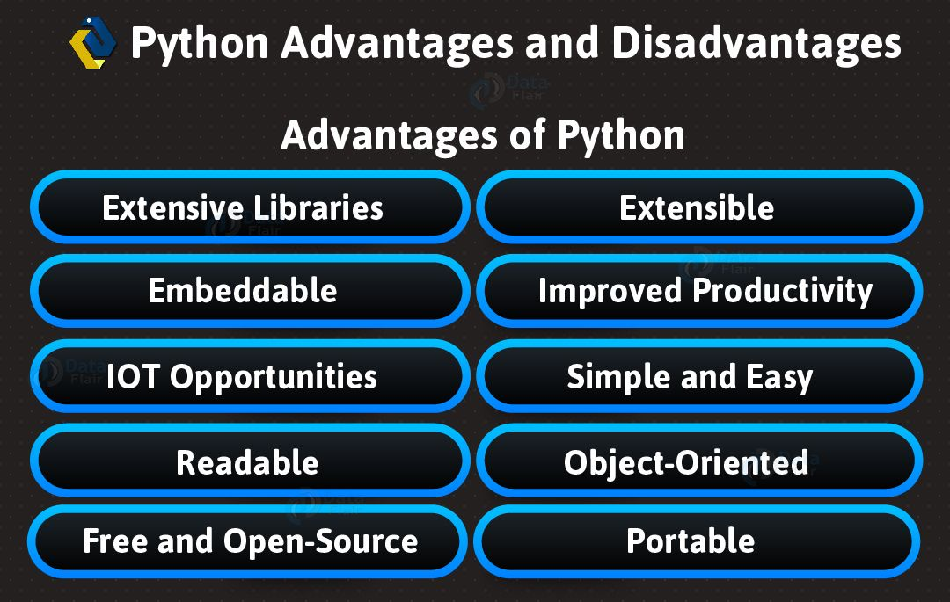

Slide 12
Variable types
Example types.py: pi = 3.1415926 message = "Hello, world" i = 2+2 print(type(pi)) print(type(message)) print(type(i)) Output: <type 'float'> <type 'str'> <type 'int'>

Slide 13
Variable names
Can contain letters, numbers, and underscores
Must begin with a letter or underscore
Cannot be one of the reserved Python keywords: and, as, assert, break, class, continue, def, del, elif, else, except, exec, finally, for, from, global, if, import, in, is, lambda, not, or, pass, print, raise, return, try, while, with, yield

Slide 14
More on variable names
Names starting with one underscore (_V) are not imported from the module import * statement
Names starting and ending with 2 underscores are special, system-defined names (e.g., __V__)‏
Names beginning with 2 underscores (but without trailing underscores) are local to a class (__V)‏
A single underscore (_) by itself denotes the result of the last expression

Slide 15
Operators
+ addition
- subtraction
/ division
** exponentiation
% modulus (remainder after division)‏
Comparison operators

Slide 16
Operators
Example
print(2*2) print(2**3) print(10%3) print(1.0/2.0) print(1/2)
Note the difference between floating point division and integer division in the last two lines
Python has incorporated operators like +=, but ++ (or --) do not work in Python
Output: 4 8 1 0.5 0.5

Slide 17
String Methods: find, split
smiles = "C(=N)(N)N.C(=O)(O)O"
>>> smiles.find("(O)")
15
>>> smiles.find(".") #Use “find” to find the start of a substring.
9
>>> smiles.find(".", 10) #Start looking at position 10.
-1 #Find returns -1 if it couldn’t find a match.
>>> smiles.split(".") #Split the string into parts with “.” as the delimiter
['C(=N)(N)N', 'C(=O)(O)O']
>>>

Slide 18
String operators: in, not in
if "Br" in “Brother”:
print("contains brother“)
email_address = “clin”
if "@" not in email_address:
email_address += "@brandeis.edu“

Slide 19
String Method
“strip”, “rstrip”, “lstrip” are ways to remove whitespace or selected characters
>>> line = " # This is a comment line \n“
>>> line.strip()
'# This is a comment line‘
>>> line.rstrip()
' # This is a comment line‘
>>> line.rstrip("\n")
' # This is a comment line '

Slide 20
More String methods
email.startswith(“c") endswith(“u”)
True/False
>>> "%s@brandeis.edu" % "clin"
'clin@brandeis.edu'
>>> names = [“Ben", “Chen", “Yaqin"]
>>> ", ".join(names)
‘Ben, Chen, Yaqin‘
>>> “chen".upper()
‘CHEN'

Slide 21
Unexpected things about strings
>>> s = "andrew"
>>> s[0] = "A"
Traceback (most recent call last):
File "<stdin>", line 1, in <module>
TypeError: 'str' object does not support item assignment
>>> s = "A" + s[1:]
>>> s
'Andrew‘
Strings are read only

Slide 22
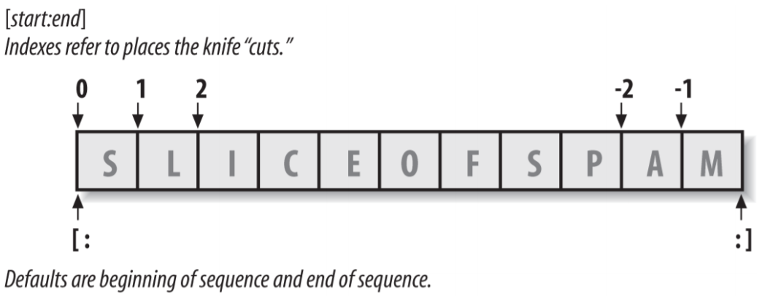
String Slicing and Indexing
Slicing (S[i:j]) extracts contiguous sections of sequences:
• The upper bound is non-inclusive.
• Slice boundaries default to 0 and the sequence length, if omitted.
• S[1:3] fetches items at offsets 1 up to but not including 3.
• S[1:] fetches items at offset 1 through the end (the sequence length).
• S[:3] fetches items at offset 0 up to but not including 3.
• S[:−1] fetches items at offset 0 up to but not including the last item.
• S[:] fetches items at offsets 0 through the end—making a top-level copy of S.
Indexing (S[i]) fetches components at offsets:
• The first item is at offset 0.
• Negative indexes mean to count backward from the end or right.
• S[0] fetches the first item.
• S[−2] fetches the second item from the end (like S[len(S)−2]).
Extended slicing (S[i:j:k]) accepts a step (or stride) k, which defaults to +1:
• Allows for skipping items and reversing order—see the next section.

Slide 23
“\” is for special characters
\n -> newline
\t -> tab
\\ -> backslash
...
But Windows uses backslash for directories!
filename = "M:\nickel_project\reactive.smi" # DANGER!
filename = "M:\\nickel_project\\reactive.smi" # Better!
filename = "M:/nickel_project/reactive.smi" # Usually works

Slide 24
String backslash characters
\newline Ignored (continuation line)
\\ Backslash (stores one \)
\' Single quote (stores ')
\" Double quote (stores ")
\a Bell
\b Backspace
\f Formfeed
\n Newline (linefeed)
\r Carriage return
\t Horizontal tab
\v Vertical tab
\xhh Character with hex value hh (exactly 2 digits)
\ooo Character with octal value ooo (up to 3 digits)
\0 Null: binary 0 character (doesn’t end string)
\N{ id } Unicode database ID
\uhhhh Unicode character with 16-bit hex value
\Uhhhhhhhh Unicode character with 32-bit hex value
\other Not an escape (keeps both \ and other

Slide 25
Type conversion
int(), float(), str(), and bool() convert to integer, floating point, string, and boolean (True or False) types, respectively
Example typeconv.py: print(1.0/2.0) print(1/2) print(float(1)/float(2)) print(int(3.1415926)) print(str(3.1415926)) print(bool(1)) print(bool(0)‏)
Output: 0.5 0.5 0.5 3 3.1415926 True False

Slide 26
Formatting Expression Syntax
%[(keyname)][flags][width][.precision]typecode
Provide a key name for indexing the dictionary used on the right side of the expression
• List flags that specify things like left justification (−), numeric sign (+), a blank before positive numbers and a – for negatives (a space), and zero fills (0)
• Give a total minimum field width for the substituted text
• Set the number of digits (precision) to display after a decimal point for floating point numbers
>>> x = 1234
>>> res = 'integers: ...%d...%−6d...%06d' % (x, x, x)
>>> res
'integers: ...1234...1234 ...001234'

Slide 27
Formatting Method Syntax
{fieldname component !conversionflag :formatspec}
fieldname is an optional number or keyword identifying an argument, which may be omitted to use relative argument numbering in 2.7, 3.1, and later.
component is a string of zero or more “.name” or “[index]” references used to fetch attributes and indexed values of the argument, which may be omitted to use the whole argument value.
conversionflag starts with a ! if present, which is followed by r, s, or a to call repr, str, or ascii built-in functions on the value, respectively.
formatspec starts with a : if present, which is followed by text that specifies how the value should be presented, including details such as field width, alignment, padding, decimal precision, and so on, and ends with an optional data type code.
[[fill]align][sign][#][0][width][,][.precision][typecode]

Slide 28
Formatting Method Syntax
>>> '{motto}, {0} and {food}'.format(42, motto=3.14, food=[1, 2])
'3.14, 42 and [1, 2]'
>>> '{0:.2f}'.format(1 / 3.0) # Parameters hardcoded
'0.33'
>>> '%.2f' % (1 / 3.0) # Ditto for expression
'0.33'
>>> '{0:.{1}f}'.format(1 / 3.0, 4) # Take value from arguments
'0.3333'
>>> '%.*f' % (4, 1 / 3.0) # Ditto for expression
'0.3333'
>>> '{0:.2f}'.format(1.2345) # String method
'1.23'
>>> format(1.2345, '.2f') # Built-in function
‘1.23'
>>> '%.2f' % 1.2345 # Expression
'1.23'

Slide 29
Operators acting on strings
>>> "Ni!"*3 'Ni!Ni!Ni!'
>>> "hello " + "world!" 'hello world!'

Slide 30
Input from keyboard
Example input.py i = raw_input("Enter a math expression: ") #Python 2.7 print i j = input("Enter the same expression: ") #Python 3+ print(j) Output: Enter a mathematical expression: 3+2 3+2 Enter the same expression: 3+2 5

Slide 31
Conditionals
True and False booleans
Comparison and Logical Operators
if, elif, and else statements

Slide 32
Booleans: True and False
>>> type (True) <type 'bool'> >>> type (true) Traceback (most recent call last): File "<stdin>", line 1, in <module> NameError: name 'true' is not defined >>> 2+2==5 False
Note: True and False are of type bool. The capitalization is required for the booleans!

Slide 33
Boolean expressions
A boolean expression can be evaluated as True or False. An expression evaluates to False if it is... the constant False, the object None, an empty sequence or collection, or a numerical item of value 0
Everything else is considered True

Slide 34
Comparison operators
== : is equal to?
!= : not equal to
> : greater than
< : less than
>= : greater than or equal to
<= : less than or equal to
is : do two references refer to the same object?

Slide 35
More on comparisons
Can “chain” comparisons: >>> a = 42 >>> 0 <= a <= 99 True

Slide 36
Logical operators
and, or, not >>> 2+2==5 or 1+1==2 True >>> 2+2==5 and 1+1==2 False >>> not(2+2==5) and 1+1==2 True
Note: We do NOT use &&, ||, !, as in C!

Slide 37
If statements
Example ifelse.py if (1+1==2): print "1+1==2" print("I always thought so!“) else: print("My understanding of math must be faulty!“)
Simple one-line if: if (1+1==2): print(“I can add!”)

Slide 38
elif statement
Equivalent of “else if” in C
Example elif.py: x = 3 if (x == 1): print("one“) elif (x == 2): print("two“) else: print("many“)

Slide 39
Loops/Iterations
sentence = ['Marry','had','a','little','lamb'] for word in sentence: print(word, len(word))
for i in range(10): print(i) for i in xrange(1000): # does not allocate all initially print(i)
while True: pass
for i in xrange(10): if i == 3: continue if i == 5: break print(i)

Slide 40
Flow control within loops
General structure of a loop: while <statement> (or for <item> in <object>): <statements within loop> if <test1>: break # exit loop now if <test2>: continue # go to top of loop now if <test3>: pass # does nothing! else: <other statements> # if exited loop without # hitting a break

Slide 41
Using the “loop else”
An else statement after a loop is useful for taking care of a case where an item isn't found in a list. Example: search_items.py: for i in range(3): if i == 4: print("I found 4!“) break else: print("Don't care about",i) else: print("I searched but never found 4!“)

Slide 42
Parallel traversals
If we want to go through 2 lists (more later) in parallel, can use zip: A = [1, 2, 3] B = [4, 5, 6] for (a,b) in zip(A,B): print(a, “*”, b, “=”, a*b) output: 1 * 4 = 4 2 * 5 = 10 3 * 6 = 18

Slide 43
Lists
Ordered collections of arbitrary objects
Accessed by offset
Variable-length, heterogeneous, and arbitrarily nestable
Of the category “mutable sequence”
Arrays of object references

Slide 44
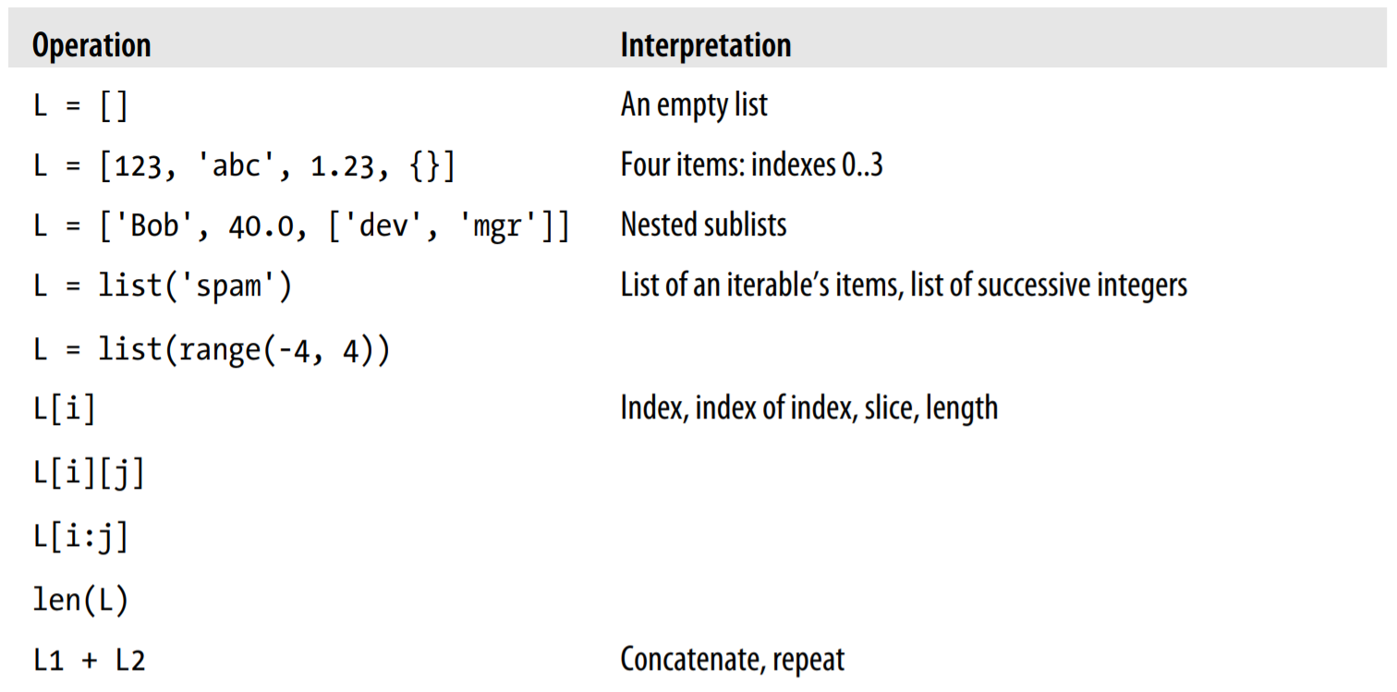
Lists

Slide 45
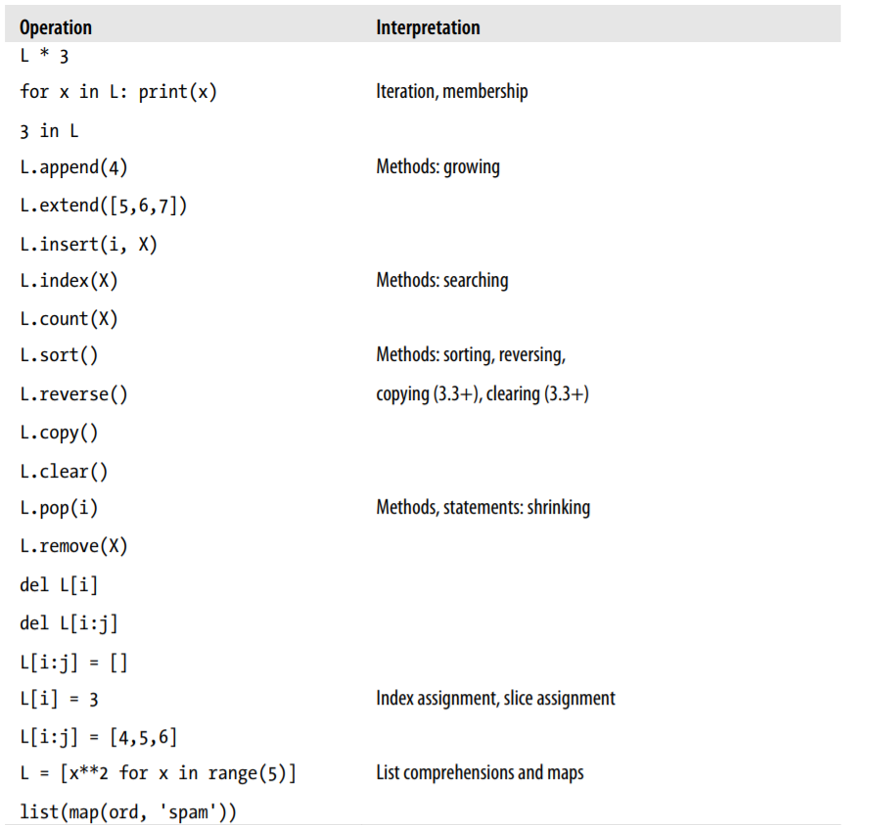
Lists

Slide 46
Lists in Action
Basic List Operations
List Iteration and Comprehensions
Indexing, Slicing, and Matrixes
Changing Lists in Place

Slide 47
Dictionaries
Accessed by key, not offset position
Unordered collections of arbitrary objects
Variable-length, heterogeneous, and arbitrarily nestable
Of the category “mutable mapping”
Tables of object references (hash tables)

Slide 48
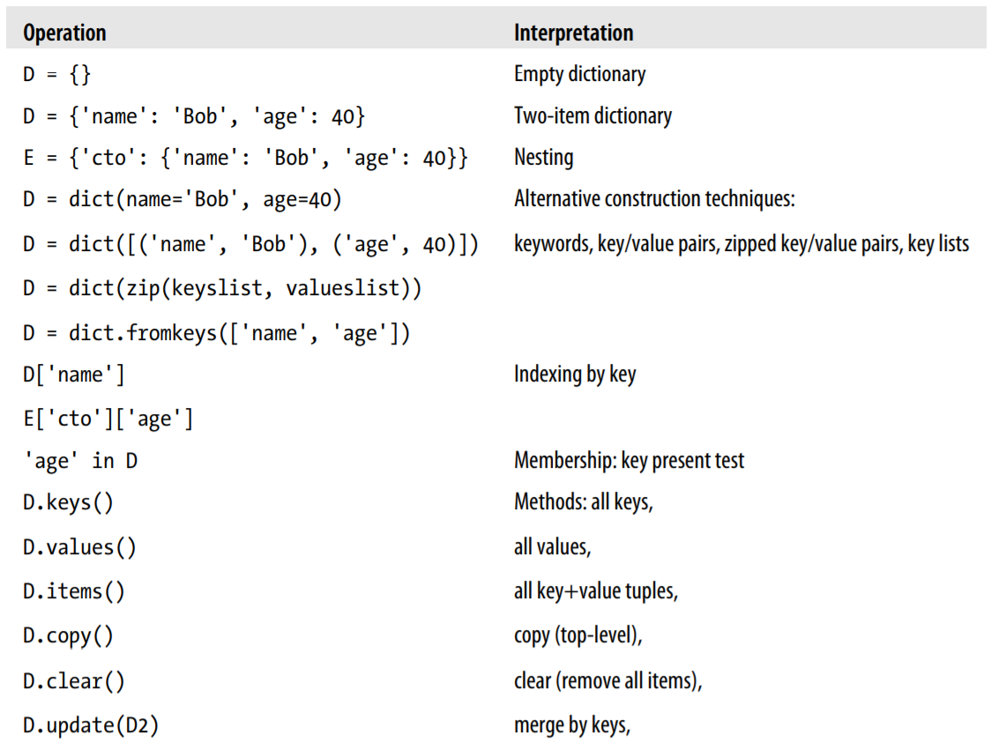
Dictionaries

Slide 49
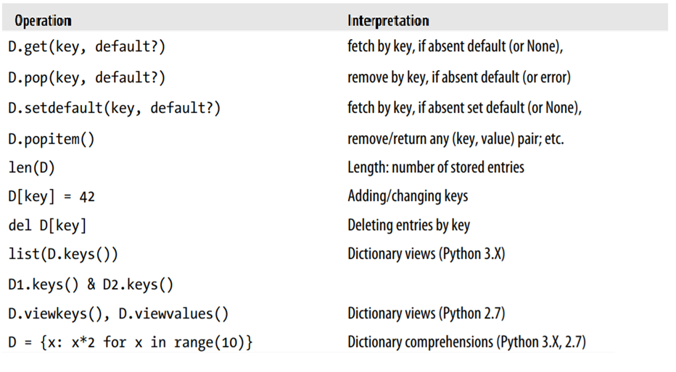
Dictionaries

Slide 50
Tuples
Ordered collections of arbitrary objects
Accessed by offset
Of the category “immutable sequence”
Fixed-length, heterogeneous, and arbitrarily nestable
Arrays of object references

Slide 51
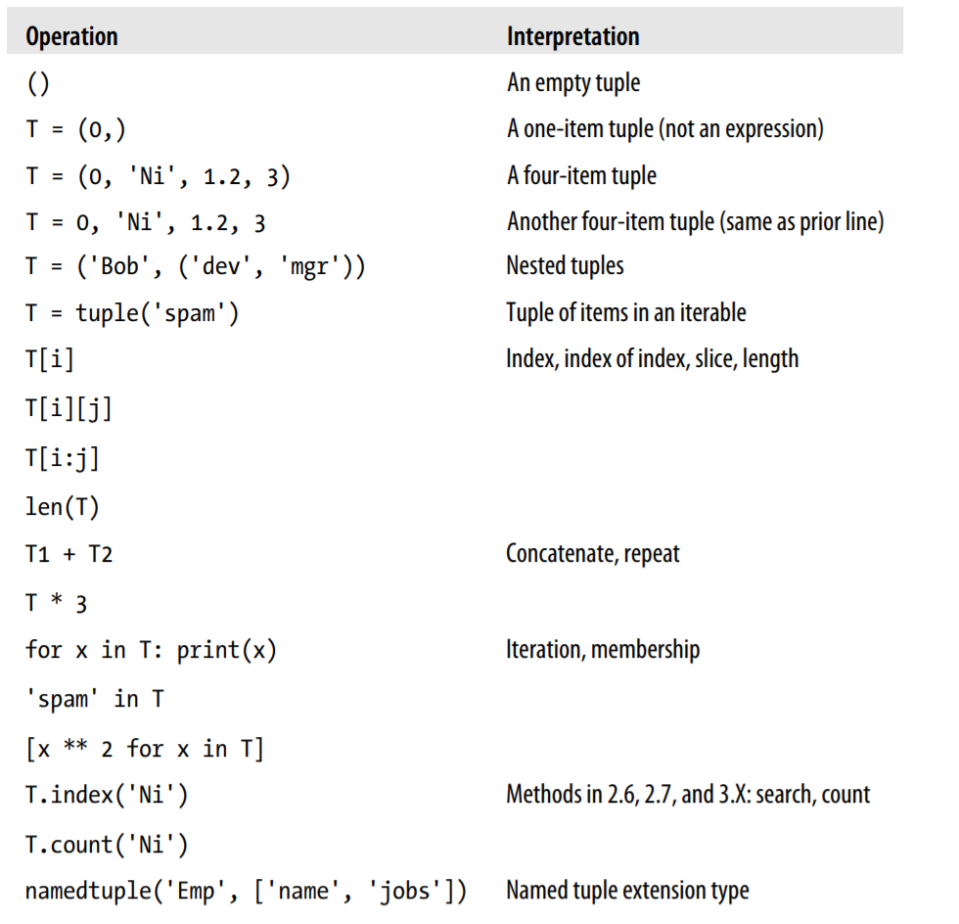
Tuples

Slide 52
Sets
Unordered collections of arbitrary objects
Can not be accessed by offset
Variable-length, heterogeneous, and arbitrarily nestable
Of the category “immutable sequence”
Arrays of object references

Slide 53
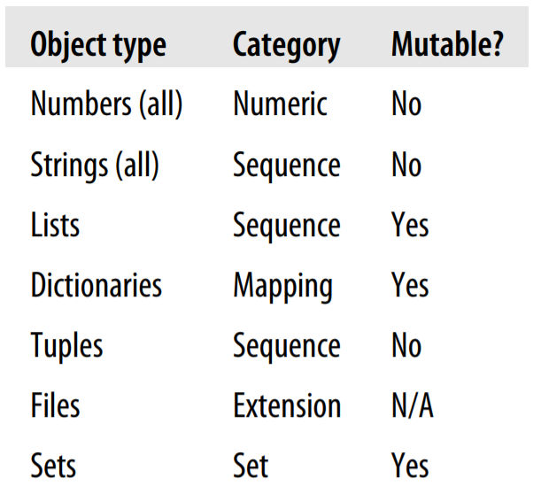
Mutable or Immutable?

Slide 54
Functions
What?
a device that groups a set of statements so they can be run more than once in a program
Why?
Maximizing code reuse and minimizing redundancy
Procedural decomposition

Slide 55
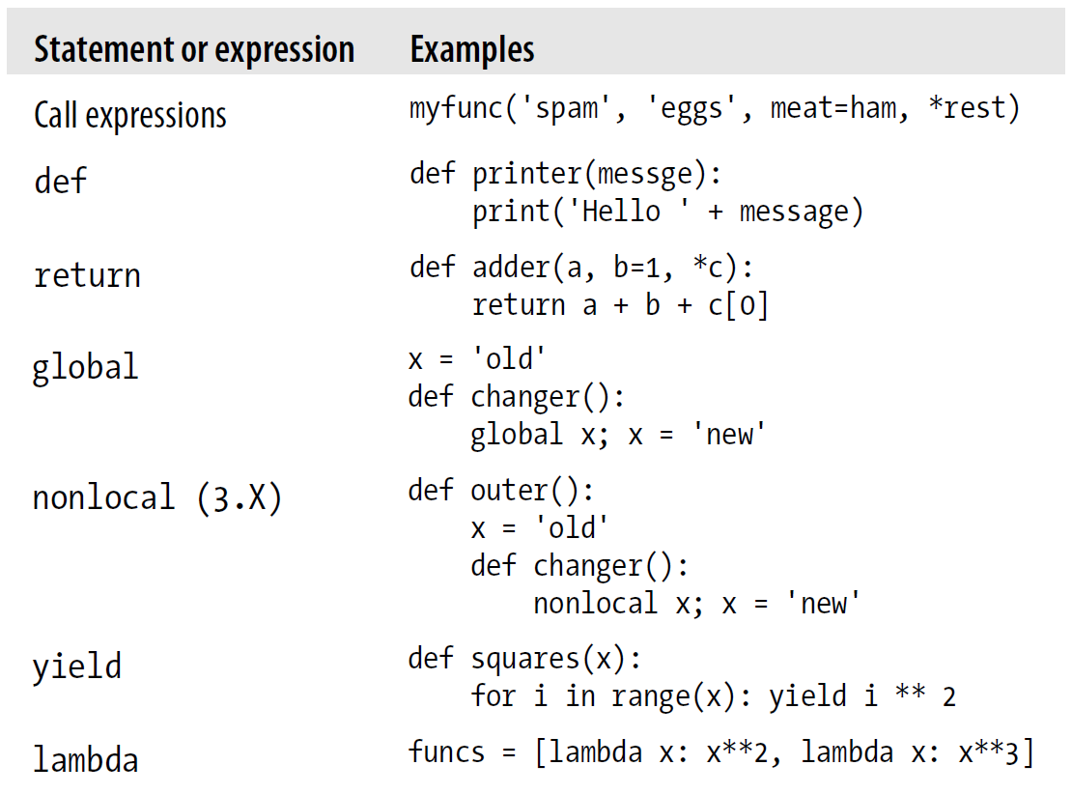
Functions

Slide 56
Functions
def is executable code
def creates an object and assigns it to a name
return sends a result object back to the caller
lambda creates an object but returns it as a result
yield sends a result object back to the caller, but remembers where it left off
def Executes at Runtime

Slide 57
Functions
global declares module-level variables that are to be assigned
nonlocal declares enclosing function variables that are to be assigned
Arguments are passed by assignment (object reference)
Arguments are passed by position, unless you say otherwise
Arguments, return values, and variables are not declared

Slide 58
Function - variables scope
Names assigned inside a def can only be seen by the code within that def
Names assigned inside a def do not clash with variables outside the def
If a variable is assigned inside a def, it is local to that function.
If a variable is assigned in an enclosing def, it is nonlocal to nested functions.
If a variable is assigned outside all defs, it is global to the entire file.

Slide 59
Function – variables scope
X = 99 # Global (module) scope X
def func():
X = 88 # Local (function) scope X: a different variable
func()
print(x) #99 - as X within func() is local and will not change global X
Assigned names are local unless declared global or nonlocal
All other names are enclosing function locals, globals, or built-ins
Each call to a function creates a new local scope

Slide 60
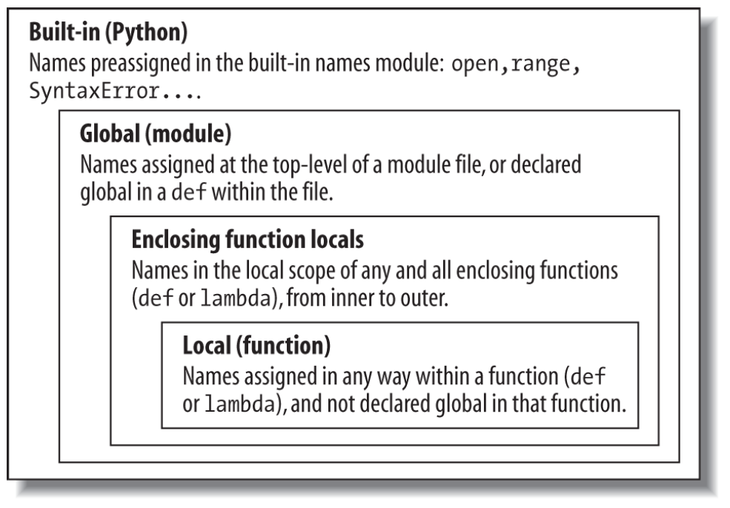
Function – variables scope
Name Resolution: The LEGB Rule
When you use an unqualified name inside a function, Python searches up to four scopes—
the local (L) scope,
then the local scopes of any enclosing (E) defs and lambdas,
then the global (G) scope,
and then the built-in (B) scope

Slide 61
Functions – variables scope
# Global scope
X = 99 # X and func assigned in module: global
def func(Y): # Y and Z assigned in function: locals
# Local scope
Z = X + Y # X is a global
return Z
func(1) # func in module: result=100
y, z = 1, 2 # Global variables in module
def all_global():
global x # Declare globals assigned
x = y + z # No need to declare y, z: LEGB rule
def func():
x = 4
action = (lambda n: x ** n) # x remembered from enclosing def
return action
x = func()
print(x(2)) # Prints 16, 4 ** 2
X = 99 # Global scope name: not used
def f1():
X = 88 #Enclosing def local
def f2():
print(X) # Reference made in nested def
f2()
f1() # Prints 88: enclosing def local
def tester(start):
state = start # Each call gets its own state
def nested(label):
nonlocal state # Remembers state in enclosing scope
print(label, state)
state += 1 # Allowed to change it if nonlocal
return nested
F = tester(0)
F('spam') # State visible within closure only
spam 0
# Global X
X = 88
def func():
global X
X = 99 # Global X: outside def
func()
print(X) # Prints 99

Slide 62
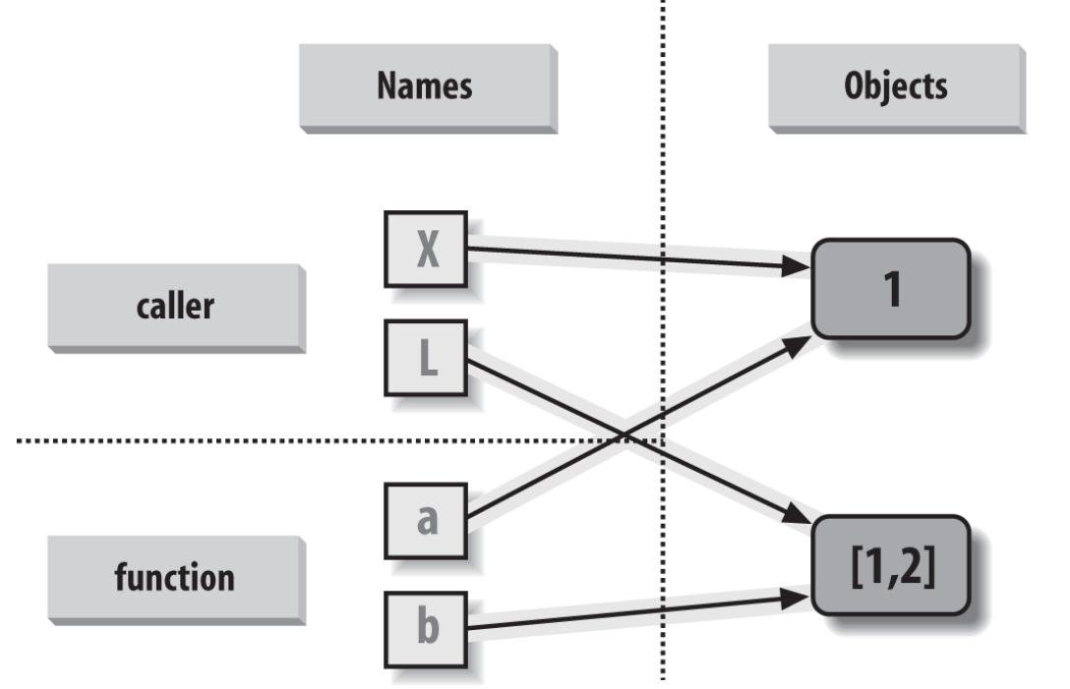
Functions - arguments
def changer(a, b): # Arguments assigned references to objects
a = 2 # Changes local name's value only
b[0] = 'spam' # Changes shared object in place
X = 1
L = [1, 2] # Caller:
changer(X, L) # Pass immutable and mutable objects
X, L # X is unchanged, L is different!
(1, ['spam', 2])
Arguments are passed by automatically assigning objects to local variable names
Assigning to argument names inside a function does not affect the caller
Changing a mutable object argument in a function may impact the caller
Immutable arguments are effectively passed “by value.”
Mutable arguments are effectively passed “by pointer.”

Slide 63
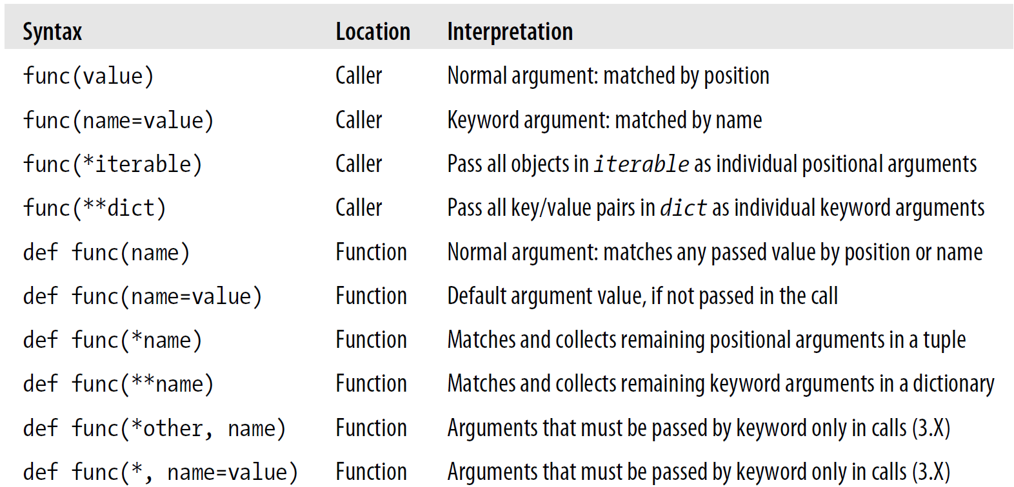
Functions - arguments

Slide 64
Functions
def func(spam, eggs, toast=0, ham=0): # First 2 required
print((spam, eggs, toast, ham))
func(1, 2) # Output: (1, 2, 0, 0)
func(1, ham=1, eggs=0) # Output: (1, 0, 0, 1)
func(spam=1, eggs=0) # Output: (1, 0, 0, 0)
func(toast=1, eggs=2, spam=3) # Output: (3, 2, 1, 0)
func(1, 2, 3, 4) # Output: (1, 2, 3, 4)

Slide 65
Anonymous Functions: lambda
lambda argument1, argument2,... argumentN : expression using arguments
lambda is an expression, not a statement
lambda’s body is a single expression, not a block of statements
>>> def func(x, y, z): return x + y + z
>>> func(2, 3, 4)
9
>>> f = lambda x, y, z: x + y + z
>>> f(2, 3, 4)
9

Slide 66
map, filter, reduce
>>> def inc(x): return x + 10 # Function to be run
>>> list(map(inc, counters)) # Collect results
[11, 12, 13, 14]
>>> list(range(−5, 5)) # An iterable in 3.X
[−5, −4, −3, −2, −1, 0, 1, 2, 3, 4]
>>> list(filter((lambda x: x > 0), range(−5, 5))) # An iterable in 3.X
[1, 2, 3, 4]
>>> from functools import reduce # Import in 3.X, not in 2.X
>>> reduce((lambda x, y: x + y), [1, 2, 3, 4])
10
>>> reduce((lambda x, y: x * y), [1, 2, 3, 4])
24

Slide 67
Generators
>>> def gensquares(N):
for i in range(N):
yield i ** 2 # Resume here later
>>> for i in gensquares(5): # Resume the function
print(i, end=' : ') # Print last yielded value
0 : 1 : 4 : 9 : 16 :
>>> x = gensquares(4)
>>> x
<generator object gensquares at 0x000000000292CA68>
>>> next(x) # Same as x.__next__() in 3.X
0
>>> next(x) # Use x.next() or next() in 2.X
1
>>> next(x)
4
>>> next(x)
9
>>> next(x)
Traceback (most recent call last):
File "<stdin>", line 1, in <module>
StopIteration

Slide 68
Module
Code reuse
System namespace partitioning
Implementing shared services or data

Slide 69
The Module Search Path
1. The home directory of the program
2. PYTHONPATH directories (if set)
3. Standard library directories
4. The contents of any .pth files (if present)
5. The site-packages home of third-party extensions

Slide 70
Module
The import Statement
>>> import module1 # Get module as a whole (one or more)
>>> module1.printer('Hello world!') # Qualify to get names
Hello world!
The from Statement
>>> from module1 import printer # Copy out a variable (one or more)
>>> printer('Hello world!') # No need to qualify name
Hello world!
The from * Statement
>>> from module1 import * # Copy out _all_ variables
>>> printer('Hello world!')
Hello world!

Slide 71
Package
Packages are simply directories of Python modules with a special __init__.py file,
which enables A.B.C directory path syntax in imports.
import dir1.dir2.mod
from dir1.dir2.mod import x
__init__.py Files
Relative import with . Operator
from __future__ import absolute_import # Use 3.X relative import model in 2.X

Slide 72
Regular Expression
Text-matching patterns described with a formal syntax
For finding repetition, to text-matching
import re
# List of patterns to search for
patterns = ['term1', 'term2']
# Text to parse
text = 'This is a string with term1, but it does not have the other term.'
for pattern in patterns:
('Searching for "%s" in:\n "%s"\n' %(pattern,text)) #Check for match
if re.search(pattern,text):
('Match was found. \n')
else:
('No Match was found.\n')

Slide 73
Regular Expression
re.search()
re.split()
re.findall()
Repetition Syntax
There are five ways to express repetition in a pattern:
A pattern followed by the meta-character * is repeated zero or more times.
Replace the * with + and the pattern must appear at least once.
Using ? means the pattern appears zero or one time.
For a specific number of occurrences, use {m} after the pattern, where m is replaced with the number of times the pattern should repeat.
Use {m,n} where m is the minimum number of repetitions and n is the maximum. Leaving out n {m,} means the value appears at least m times, with no maximum.
Use ^ to exclude terms by incorporating it into the bracket syntax notation.

